Slide 1
Lecture 11
Topics: Polymorphism
Chapter 11, Sections 11.7 - 11.10

Slide 2

The 3 pillars of object-oriented programming
Encapsulation
Inheritance
Polymorphism

Slide 3
What is polymorphism?
From the Greek roots “poly” meaning “many” and “morphe” meaning forms (i.e. having many forms).
The subtype extends the supertype... (aka subclass and superclass).
A subclass is a specialization of the superclass.
Thus, every instance (i.e. every object) of a subclass is an instance (an object) of the superclass, but not vice versa.
Any subclass of a superclass can be substituted where the superclass is expected.

Slide 4
public class Animal
{
public void makeNoise()
{
System.out.println("Groowwwwwl");
}
}
public class Dog extends Animal
{
@Override
public void makeNoise()
{
System.out.println("Ruff");
}
}

Slide 5
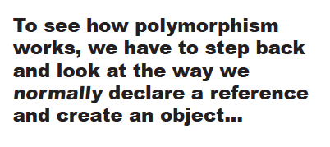
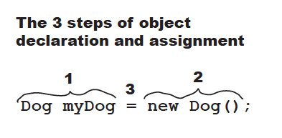

Slide 6
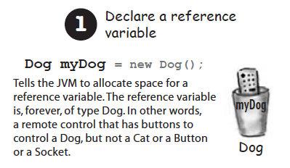
Terminology
When you say: Dog myDog
Declared Type

Slide 7
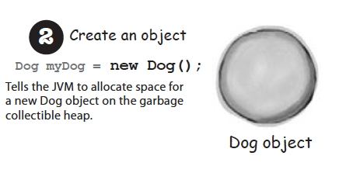
Terminology
When you say: new Dog()
Actual Type

Slide 8
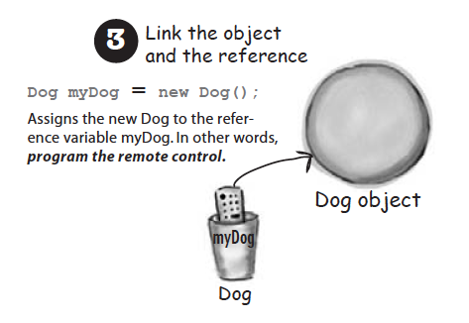
When you say: Dog myDog = new Dog()

Slide 9
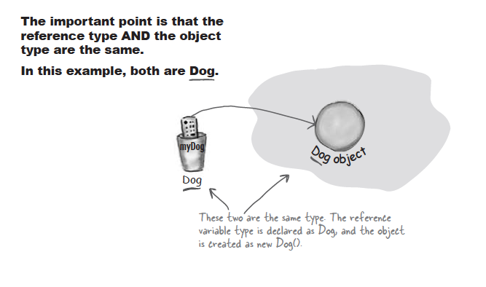

Slide 10
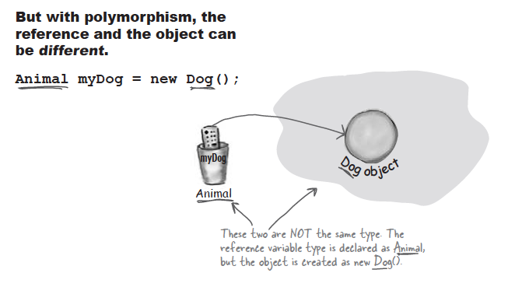
Actual Type
Declared Type
. . . as long as Dog extends Animal or extends another class that ultimately extends Animal.

Slide 11



Slide 12
makeNoise()
eat()
sleep()
roam()
Animal
Let’s also imagine
that we’ve overridden
the methods in each
class.
Dog extends Animal
Hippo extends Animal
Cat extends Animal
Wolf extends Animal
Lion extends Animal

Slide 13
Declare an array of type Animal. In other
words, an array that will hold objects of type
Animal.
Animal[] animals = new Animal[5];
animals[0] = new Dog();
animals[1] = new Cat();
animals[2] = new Wolf();
animals[3] = new Hippo();
animals[4] = new Lion();
for (int i = 0; i < animals.length; i++)
{
Animal tempA = animals[i];
tempA.eat();
tempA.makeNoise();
}
Look what you can do! You can put any subclass of Animal in the Animal array!
When i is 0, you get Dog’s eat() and makeNoise() methods.
When i is 3, you get the Hippo’s eat() and makeNoise() method.

Slide 14


Now, that is awesome...

Slide 15
There's more!
You can have polymorphic arguments and polymorphic return types!
public class Animal
{
public void makeNoise()
{
S.O.P.L("Groowwwwwl");
}
}
public class Cat extends Animal
{
@Override
public void makeNoise()
{
S.O.P.L("Meow");
}
}
public class Dog extends Animal
{
@Override
public void makeNoise()
{
S.O.P.L("Ruff");
}
}
public class Vet
{
public static void giveShot(Animal poorAnimal)
{
poorAnimal.makeNoise();
}
}
Any type of animal can go to the Vet to get a shot!

Slide 16
public class Vet
{
public void giveShot(Animal poorAnimal)
{
poorAnimal.makeNoise();
}
}
The Vet’s giveShot() method can take any
Animal you give it as long as it is a subclass
of Animal.
public class Dog extends Animal
{
@Override
public void makeNoise()
{
S.O.P.L("Ruff");
}
}
public class PetOwnerTest
{
public static void main(String[] args)
{
Vet doctor = new Vet();
Dog fido = new Dog();
Cat fred = new Cat();
doctor.giveShot(fido);
doctor.giveShot(fred);
}
}
public class Cat extends Animal
{
@Override
public void makeNoise()
{
S.O.P.L("Meow");
}
}
Dog’s makeNoise() method is called.
Cat's makeNoise() method is called.
public class Animal
{
public void makeNoise()
{
S.O.P.L("Groowwwwwl");
}
}

Slide 17
The catch with polymorphism
The method you’re calling on a reference variable MUST be in the class of the Declared Type.
Declared Type
Actual Object Type
Object fido = new Dog();
S.O.P.L(fido.toString());
fido.makeNoise();
This is correct. The method toString() belongs to Object
This is NOT correct. The method
makeNoise() belongs to Animal
and Object does not extend Animal.

Slide 18
public class First
{
public void method2()
{
S.O.P.L("First2");
}
public void method3()
{
method2();
}
}
public class Second
extends First
{
public void method2()
{
S.O.P.L("Second2");
}
}
-----------------------
method3()
public class Third extends
Second
{
public void method1()
{
S.O.P.L("Third1");
super.method2()
}
public void method2()
{
S.O.P.L("Third2");
}
}
-----------------------
method3()
public class Fourth extends
First
{
public void method1()
{
S.O.P.L("Fourth1");
super.method2()
}
public void method2()
{
S.O.P.L("Fourth2");
}
}
-----------------------
method3()
var1.method2();
Declared Type: First
Actual Type: Second
Second extends First.
Does method2 exist in both? Yes.
Output: Second2
var2.method2();
Declared Type: First
Actual Type: Third
Third extends Second extends First.
Does method2 exist in both? Yes.
Output: Third2
First var1 = new Second();
First var2 = new Third();
First var3 = new Fourth();
Second var4 = new Third();
Object var5 = new Fourth();
Object var6 = new Second();
public class Object
{
public boolean equals(Object obj)
{
}
public String toString()
{
}
}

Slide 19
public class First
{
public void method2()
{
S.O.P.L("First2");
}
public void method3()
{
method2();
}
}
public class Second
extends First
{
public void method2()
{
S.O.P.L("Second2");
}
}
-----------------------
method3()
public class Third extends
Second
{
public void method1()
{
S.O.P.L("Third1");
super.method2()
}
public void method2()
{
S.O.P.L("Third2");
}
}
-----------------------
method3()
public class Fourth extends
First
{
public void method1()
{
S.O.P.L("Fourth1");
super.method2()
}
public void method2()
{
S.O.P.L("Fourth2");
}
}
-----------------------
method3()
var5.method2();
Declared Type: Object
Actual Type: Fourth
Fourth extends Object
Does method2 exist in both? No.
Compile Error
var6.method2();
Declared Type: Object
Actual Type: Second
Second extends Object
Does method2 exist in both? No.
Compile Error
First var1 = new Second();
First var2 = new Third();
First var3 = new Fourth();
Second var4 = new Third();
Object var5 = new Fourth();
Object var6 = new Second();
public class Object
{
public boolean equals(Object obj)
{
}
public String toString()
{
}
}

Slide 20
public class First
{
public void method2()
{
S.O.P.L("First2");
}
public void method3()
{
method2();
}
}
public class Second
extends First
{
public void method2()
{
S.O.P.L("Second2");
}
}
-----------------------
method3()
public class Third extends
Second
{
public void method1()
{
S.O.P.L("Third1");
super.method2()
}
public void method2()
{
S.O.P.L("Third2");
}
}
-----------------------
method3()
public class Fourth extends
First
{
public void method1()
{
S.O.P.L("Fourth1");
super.method2()
}
public void method2()
{
S.O.P.L("Fourth2");
}
}
-----------------------
method3()
var1.method3();
Declared Type: First
Actual Type: Second
Second extends First
Does method3 exist in both? Yes.
Output: Second2
var2.method3();
Declared Type: First
Actual Type: Third
Third extends Second extends First
Does method3 exist in both? Yes.
Output: Third2
First var1 = new Second();
First var2 = new Third();
First var3 = new Fourth();
Second var4 = new Third();
Object var5 = new Fourth();
Object var6 = new Second();
public class Object
{
public boolean equals(Object obj)
{
}
public String toString()
{
}
}

Slide 21
How is equals() defined in the Object class?
public boolean equals(Object obj)
{
if (this == obj)
return true;
else
return false;
}
But, this equality only returns true if two
objects have the same location in memory.

Slide 22
public class Animal
{
public boolean equals(Animal animal)
{
//Do stuff and return boolean
}
@Override
public boolean equals(Object animal)
{
//Do stuff and return boolean
}
}
Overloading: The parameter types are different.
Overriding: The parameter types are the same.
It is considered bad practice to overload the Object methods
because it can lead to unexpected behavior.
Notes:
Many Java data structures (like the contains method from ArrayList) implement the equals method.
If you have overloaded the equals for your object hanging out in the arraylist and didn't override, then the object equals method will be used - not your overloaded method.

Slide 23


Arrrgh, what do I do?? I’m stuck with this equals method that I should only override - which means that it can only take Object arguments.
That’s ok. An Animal is an Object
Arrrgh, no it’s not ok! Even though an Animal is an Object, since the parameter type is Object, I can only use methods that the Object class has!
Still ok. That’s why Java gave us casting.

Slide 24
Casting
One object reference can be typecast into another object reference.
Two ways: Implicit vs. Explicit
public class Person
{
@Override
public String toString()
{
return "Person";
}
}
✔
Object o = new Student();
Student b = o;
Student b = (Student) o;
Implicit casting
✗
✔
Explicit casting
A Student object is always an instance of Object.
We can see that o is an actual Student object, but the Java compiler can't tell.
Upcasting: subclass to superclass, implicit
Downcasting: superclass to subclass, explicit, the actual object type must be the subclass
Casting happens at runtime!

Slide 25
public class Dog extends Animal
{
public Dog()
{
super(4);
}
}
public class Animal
{
private int legs;
public Animal(int legs)
{
this.legs = legs;
}
public int getLegs()
{
return this.legs;
}
@Override
public boolean equals(Object a)
{
Animal a2 = (Animal) a;
int n1 = this.getLegs();
int n2 = a2.getLegs();
return (n1 == n2);
}
}
public class Bird extends Animal
{
public Bird()
{
super(2);
}
}
public static void main(String[] args)
{
Dog d = new Dog();
Bird b = new Bird();
Animal an = new Animal(4);
Object o = new Animal(4);
System.out.println(d.equals(b));
System.out.println(an.equals(d));
System.out.println(o.equals(an));
}

Slide 26
public class First
{
public void method2()
{
S.O.P.L("First2");
}
public void method3()
{
method2();
}
}
public class Second
extends First
{
public void method2()
{
S.O.P.L("Second2");
}
}
-----------------------
method3()
public class Third extends
Second
{
public void method1()
{
S.O.P.L("Third1");
super.method2()
}
public void method2()
{
S.O.P.L("Third2");
}
}
-----------------------
method3()
public class Fourth extends
First
{
public void method1()
{
S.O.P.L("Fourth1");
super.method2()
}
public void method2()
{
S.O.P.L("Fourth2");
}
}
-----------------------
method3()
((Second) var4).method1();
Declared Type: Second
Actual Type: Third
Third extends Second
Cast: Second
Third extends Second - cast ok.
Does method1 exist in both? No.
Runtime Error
((Third) var4).method1();
Declared Type: Second
Actual Type: Third
Third extends Second
Cast: Third
Third is Third - cast ok.
Does method1 exist in Third? Yes.
Output:
Third1
Second2
First var1 = new Second();
First var2 = new Third();
First var3 = new Fourth();
Second var4 = new Third();
Object var5 = new Fourth();
Object var6 = new Second();
public class Object
{
public boolean equals(Object obj)
{
}
public String toString()
{
}
}

Slide 27
public class First
{
public void method2()
{
S.O.P.L("First2");
}
public void method3()
{
method2();
}
}
public class Second
extends First
{
public void method2()
{
S.O.P.L("Second2");
}
}
-----------------------
method3()
public class Third extends
Second
{
public void method1()
{
S.O.P.L("Third1");
super.method2()
}
public void method2()
{
S.O.P.L("Third2");
}
}
-----------------------
method3()
public class Fourth extends
First
{
public void method1()
{
S.O.P.L("Fourth1");
super.method2()
}
public void method2()
{
S.O.P.L("Fourth2");
}
}
-----------------------
method3()
((Third) var5).method1();
Declared Type: Object
Actual Type: Fourth
Fourth extends Object
Cast: Third
Fourth does not extend Third - cast fail.
Runtime Error
((First) var6).method3();
Declared Type: Object.
Actual Type: Second
Second extends Object
Cast: First
Second extends First - cast ok.
Does method3 exist in both? Yes.
Output: Second2
First var1 = new Second();
First var2 = new Third();
First var3 = new Fourth();
Second var4 = new Third();
Object var5 = new Fourth();
Object var6 = new Second();
public class Object
{
public boolean equals(Object obj)
{
}
public String toString()
{
}
}

Slide 28

That’s all for today!
Homework #7 is due Thursday, 03/10/16 at 9:00 a.m.
Read your book!!

